Slide 1


Python Programming Fundamentals Course
Duration: 10 Training Hours
Instructor: Boudjenah Youcef essedik Full stack developper

Slide 2

Unit 1:
Kickoff and Fundamentals

Slide 3

Why Python?
1. Simplicity and Clarity:
Code resembles plain English.
2. Immense Versatility:
Web Development, Data Analysis, AI,
3. Community & Support:
Endless ready-made libraries.

Slide 4
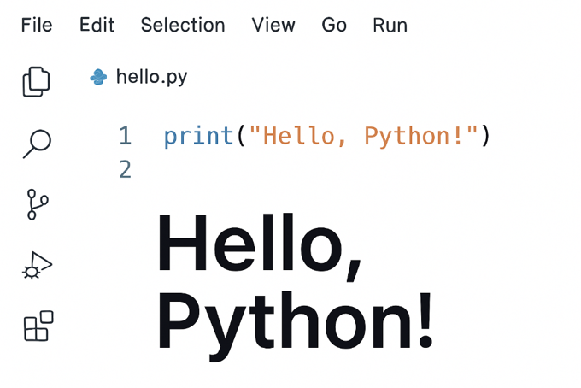
Setup and First Code
Install Python:
From the official website.
2. Code Editor (IDE):
VS Code is the preferred choice.
3. Your First Code:
print("Hello, Python!")

Slide 5
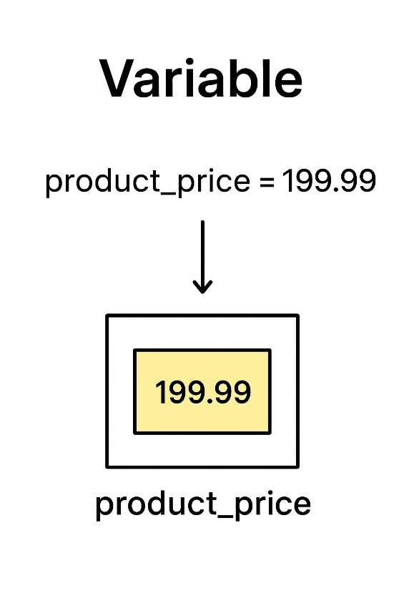
Variables
Variable: A container for storing data in memory.
Naming Rules: Must be clear, start with a letter or _, and avoid reserved keywords.
Example:
product_price = 199.99

Slide 6
Core Data Types
Numbers (Numeric)
Text (String)
Boolean
int (integers)
float (decimals).
Sequence of characters (inside quotes).
True or False
(for conditions).
price = 19.99
name = "Youcef"
is_active = True

Slide 7
Arithmetic Operations & Applications
Basics
 | Meaning | Example | Result
+ | Addition | 5 + 3 | 8
- | Subtraction | 10 - 4 | 6
* | Multiplication | 6 * 7 | 42
/ | Division | 7 / 2 | 3.5
% | Modulus (remainder) | 17 % 5 | 2

Slide 8
Arithmetic Operations & Applications
Step 1
Step 2
Precedence:
Parentheses → Multiplication/Division → Addition/Subtraction
2 + 3 * 4
(2 + 3) * 4
3*4=12
2+3=5
2+12=14
5*4=20

Slide 9
PRACTICAL APPLICATION
Invoice Calculation with Tax
price = 50.0
quantity = 3
tax_rate = 0.10
subtotal = price * quantity
tax = subtotal * tax_rate
total = subtotal + tax
subtotal = 50.0*3=150.0
tax = 150.0*0.10=15.0
total = 150.0+15.0=165.0
Final Output:
TOTAL = 165.0

Slide 10

Unit 2:
Data Structures and Control Flow

Slide 11

Lists – The Dynamic Structure
List: An ordered, mutable collection of items.
Usage: Storing a shopping list, a record of daily temperatures.
Core Operations: Adding (append)
removing (remove)
accessing by index.
Index | 0 | 1 | 2 | 3
Item | milk | bread | eggs | cheese

Slide 12
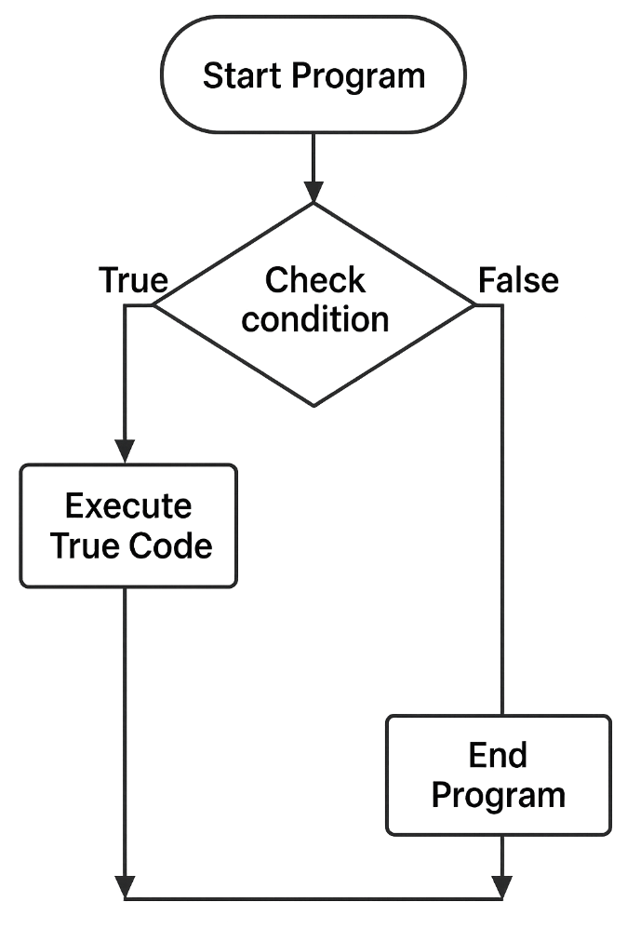
Conditional Statements (If, Elif, Else)
Lists – The Dynamic Structure
Logic: Executing specific code based on a logical condition.
Syntax: if condition: \n elif another_condition: \n else:
Logical Operators: and (both must be true), or
(at least one must be true).
List: An ordered, mutable collection of items.
Usage: Storing a shopping list, a record of daily temperatures.
Core Operations: Adding (append)
removing (remove)
accessing by index.
Index | 0 | 1 | 2 | 3
Item | milk | bread | eggs | cheese

Slide 13
Real-Life Conditional Example
Scenario: A voting eligibility system.
age = 17
if age >= 18:
print("Eligible to vote")
else:
print("Not eligible to vote")

Slide 14
For Loops -Iterating
Purpose: Repeating a set of instructions a specific number of time
(iterating over a list).
Syntax: for item in my_list: \n print(item)
Usage: Printing every item in a list, or repeating a process 10 times.
A
B
C
D

Slide 15

While Loops – Repeating Until True
Purpose: Repeating as long as a condition remains true.
Usage: Login programs (continuing to prompt until correct input).
Caution: Must have an exit condition to avoid an infinite loop.

Slide 16
Unit 3:
Code Organization and Reusability

Slide 17

Functions - Organization
Function: A block of code that is executed only when called.
Goal: Code reuse, breaking the program into small tasks.
Syntax: def function_name(parameter): \n # Code here \n return value
INPUTS
OUTPUT
FUNCTION

Slide 18
Functions: Inputs and Outputs
Parameters: The data the function needs to operate.
Return: The value produced by the function's execution.
Example: Area calculation function:
def area(length, width): \n return length * width
[ Function: area() ]
INPUTS
OUTPUT
length = 5
width = 4
def area (length, width):
return length * width
Output:20

Slide 19


Dictionaries - Key and Value
Dictionary: An unordered structure for storing data as Key-Value pairs. Usage: Storing user data, application settings.
Example: user = {"name": "Ali", "age": 30}
[ Key ] → [ Value ]
"name" → "Ali"
"age" → 30

Slide 20
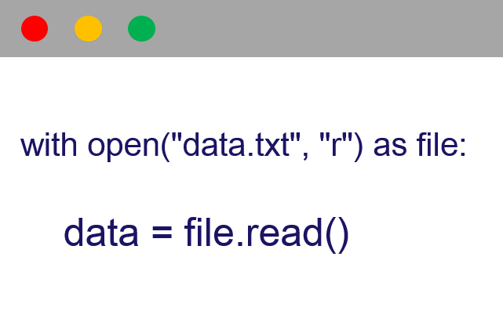

File Handling (File I/O)
Operations: Reading (r), Writing (w), Appending (a).
Safe Approach: Use with open(...) as file: to ensure proper file closure.
Application: Saving user settings or an event log to a text file.
Read (r)
Write (w), Append (a)
data,txt
Python program

Slide 21
Unit 4:
Practical Principles and Final Project

